Slide 1
Empowering Consensus: A Majority Model Approach to Collision Avoidance in Swarm Systems
NAME – SATYAM DUBEY
LAB – MULTIAGENT SYSTEMS DESIGN LAB
SUPERVISOR – DR. MUNEENDRA OJHA

Slide 2
Introduction
World where robots work together as a team to accomplish tasks that would be impossible for any single robot alone. This is the world of swarm robotics, where the power of many is harnessed to achieve great things.

Slide 3
Swarm Robotics
Swarm robotics is a field of robotics that involves the coordination of large groups of relatively simple robots to perform complex tasks.
In a swarm, robots are able to share information and coordinate their actions through a variety of means, such as direct communication or indirect sensing of their environment.

Slide 4
Majority Rule
Majority rule is a decision-making process in which the choice that has the support of the majority is chosen.
Majority Rule allows for efficient decision-making and adaptability in dynamic environments. if a robot in a swarm detects an obstacle, it can communicate this information to the other robots. The majority of robots can then decide on the best course of action, such as finding an alternate route or moving the obstacle out of the way.

Slide 5
Latent Agent
Latent agents in swarm robotics allows for more flexibility and efficiency in task allocation and coordination.
Latent Agent, the swarm can adapt to changing environmental conditions or task requirements. When the trigger condition is met, the latent agents can be activated and join the active agents to accomplish a specific objective.
Agents are shown in Red colour.

Slide 6
Non-Latent Agent
In swarm robotics, a "Non-latent agent" refers to a robot or individual unit within a swarm that is continuously active and engaged in performing tasks.
Non-latent agents actively interact with their environment, communicate with other agents in the swarm, and collaborate to accomplish complex tasks.
Agents are shown in Blue colour.

Slide 7
Agent Behaviour
Agent behaviour in swarm robotics studies how individual robots interact with each other and their environment to create emergent collective behaviours that contribute to system performance.
The behaviour of an agent is determined by rules, algorithms, or strategies that dictate how it responds to stimuli and influences from its surroundings.

Slide 8
Movement and Interaction
Movement: Agents may move in a pre-defined manner, such as random motion, following specific paths, or responding to external stimuli like obstacles or goals.
Interactions: Agents often communicate and interact with neighboring agents within a certain range. This can involve sharing information, exchanging signals, or coordinating actions.

Slide 9
Decision-Making and Consensus
Agents make decisions based on their perceptions of their environment and information from other agents. This process can be influenced by individual goals, consensus algorithms, or behavioural rules.
In collective decision-making, agents may use consensus algorithms to reach agreement on their behaviour, such as averaging opinions, voting, or adopting the majority's view.

Slide 10
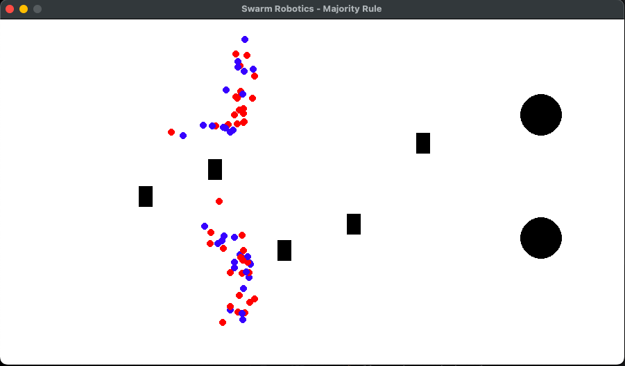
Hurdle Avoidance
The hurdle avoidance allows agents to navigate around obstacles placed in their path.
The hurdles' positions are updated by modifying their y-coordinate based on the current frame count and their respective oscillation frequency.

Slide 11
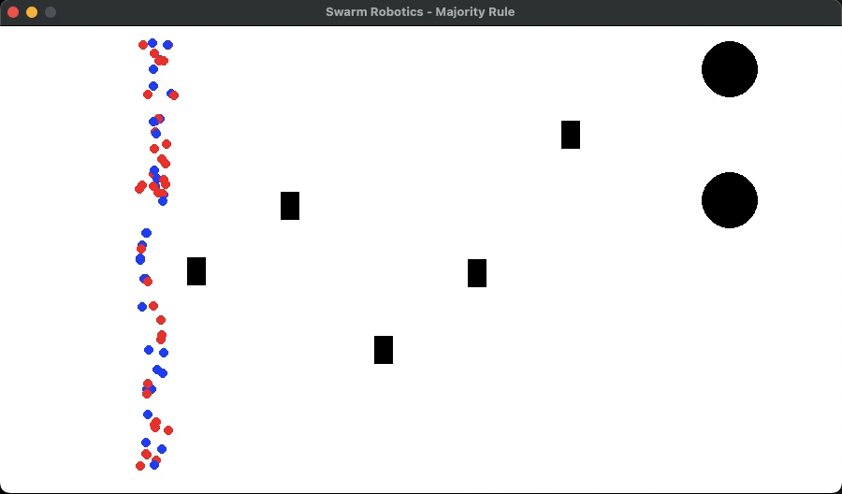
Visualization

Slide 12
Benefits of Majority Rule in Swarm Robotics
The main advantages of using majority rule in swarm robotics is increased efficiency. By allowing robots to make decisions collectively.
Another benefit of majority rule is increased adaptability. When faced with unexpected obstacles or changes in their environment, swarm robots can quickly and efficiently adjust their behaviour to overcome the challenge

Slide 13
Conclusion
In conclusion, swarm robotics is a fascinating field that has the potential to revolutionize the way we approach complex tasks.
The benefits of using majority rule in swarm robotics are numerous, including increased adaptability, fault-tolerance, and scalability.

Slide 14
Reference
https://en.wikipedia.org/wiki/Swarm_robotics
https://en.wikipedia.org/wiki/Swarm_intelligence
https://youtu.be/5lz_HnOLBW4
https://www.sciencedirect.com/topics/engineering/swarm-robotics
https://robohub.org/robust-distributed-decision-making-in-robot-swarms/
https://en.wikipedia.org/wiki/Obstacle_avoidance
https://en.wikipedia.org/wiki/Swarm_behaviour

Slide 15
Thank You

